Slide 1
Global Sales Dashboard
Sales Overview (2003–2005)

Slide 2
Data Cleaning
Removed Duplicates
Handled missing values
Fixed date format (OrderDate)
Changed data types
Trimmed and cleaned text columns

Slide 3
KPIs And Measures
KPI | Formula
Total Sales | SUM(SALES)
Average Order Values | [Total Sales]/DISTINCCOUNT(ORDERNUMBER)
Total Quantity | SUM(QUANTITYORDERED)
Total Profit | SUM(SALES)

Slide 4
Key Metrics Overview
Total Sales: $10.03M
Average Order Value: $33K
Total Quantity: 99K
Total Profit: $10.03M
Use KPI cards for visual impact

Slide 5
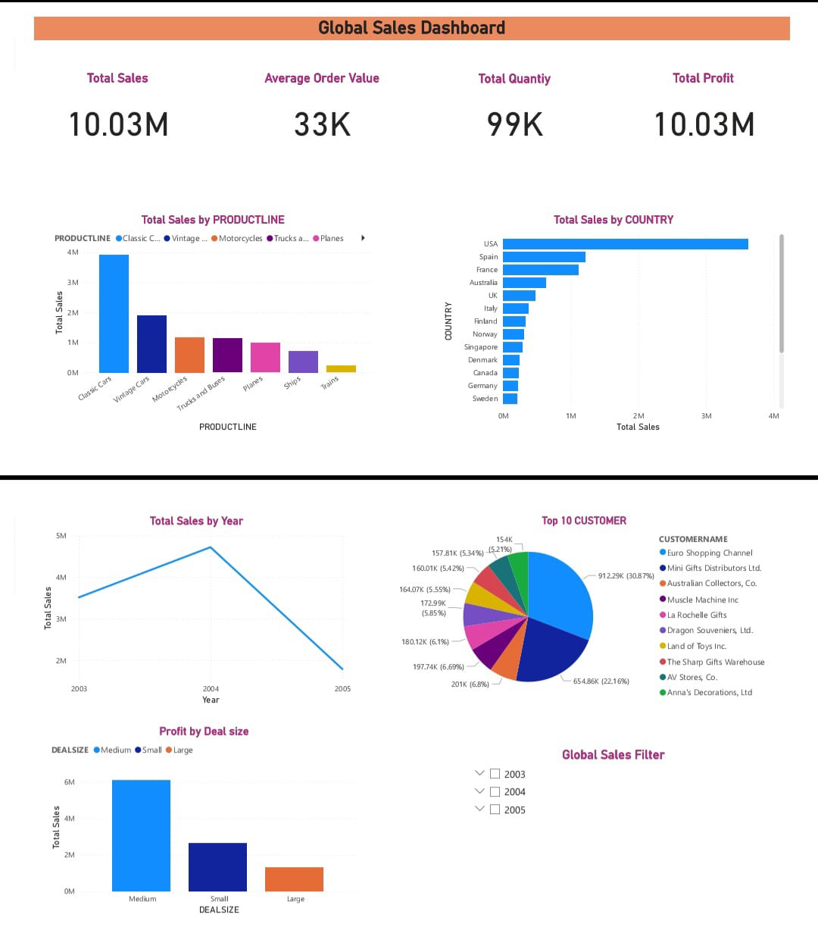
Dashboard layout
Top → KPI Cards
Middle → Charts & Trends
Bottom → Filters

Slide 6
Insights
Which Product Line Generated Most Revenue
Best Performing Country
Seasonal Sales Trend
Key Customers Contributing To Total Sales

Slide 7
conclusion
Improved visibility into sales performance
Supports business decision-making
Interactive, user-friendly dashboard

